Slide 1
Chapter 4
Induction and Recursion

Slide 2
Objectives
Mathematical Induction
Strong Induction and Well-Ordering
Recursive Definitions and Structural Induction
Recursive Algorithms

Slide 3
4.1- Mathematical Induction
Introduction
Mathematical Induction
Examples of Proofs by Mathematical Induction
Notes:
- Mathematical induction is used extensively to prove results about a large variety of discrete objects. For example, it is used to prove results about the complexity of algorithms, theorems about graphs and trees, as well as a wide range of identities and inequalities.

Slide 4
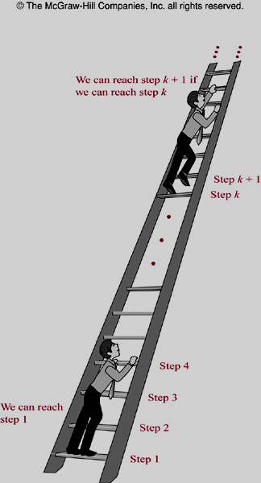
Principle of Mathematical Induction
Principle of Mathematical Induction
To prove P(n) is true for all possible integers n, where P(n) is a propositional function, we complete two step:
Basis step:
Verifying P(1) is true
Inductive step:
Show P(k) → P(k+1) is true for all k>0
Notes:
Suppose that we have an infinite ladder, as shown in Figure 1, and we want to know whether we can reach every step on this ladder. We know two things :
1. We can reach the first rung of the ladder.
2. If we can reach a particular rung of the ladder, then we can reach the next rung.
Note that statements (1) and (2) for the infinite ladder are exactly the basis step and inductive step, respectively, of the proof that Pen) is true for all positive integers n, where P(n) is the statement that we can reach the nth rung of the ladder.
Thinking of the infinite ladder and the rules for reaching steps can help you remember how mathematical induction works.

Slide 5



Slide 6
Induction: Example 1
Prove that 1 + 2 + 3+ …+ n = n(n+1)/2 for all integers n>0
Solution.
Let P(n)=“ 1+2+3+…+ n = n(n+1)/2”.
Basis step: P(1) = “1 = 1(1+1)/2” ➔ true
Inductive step: With arbitrary k>0,
P(k) =“ 1+ 2+…+ k = k(k+1)/2” is true.
We have
1+2+3+…+k+(k+1)= k(k+1)/2 + (k+1)
= [k(k+1)+ 2(k+1)]/2
= (k+1)(k+2)/2
= (k+1)((k+1)+1)/2
P(k+1)=“1+2+3+…+k+1 = (k+1)(k+2)/2” is true.
P(k) → P(k+1): true
Proved.
Notes:
Note that P(n) is entire equation, it is not only the left-hand side of the statement 1+2+3+…+ n = n(n+1)/2.

Slide 7
Example 2 p.268
Conjecture a formula for the sum of the first n positive odd integers. Then prove your conjecture using mathematical induction.
Solution.
The sum of the first n positive odd integers for n=1, 2, 3, 4, 5 are:
1=1, 1+3=4, 1+3+5=9,
1+3+5+7=16, 1+3+5+7+9=25.
Conjecture: 1+3+5+…+(2n-1)=n².
Proof. Let P(n)=“1+3+5+…+(2n-1)=n².”
- Basis step. P(1)=“1=1” is true.
- Inductive step. (P(k) P(k+1)) is true.
Suppose P(k) is true for arbitrary k > 0. That is, “1+3+5+…+(2k-1)=k²”
We have, 1+3+5+…+(2k-1)+(2k+1)=k²+2k+1 = (k+1)².
So, P(k+1) is true.
Proved.

Slide 8
Induction: Examples 2..13 – pages: 268..278
1+3+5+…+ (2n-1) = n²
2⁰+2¹+2²+2³+…+2^{n} = ∑ 2^{n} = 2^{n+1} -1
∑ar^{j} = a + ar + ar²+ … + ar^{n} = (ar^{n+1}-a)/(r-1)
n < 2^{n}
2^{n} < n! , n>3
n³-n is divisible by 3, n is positive integer
The number of subsets of a finite set: a set with n elements has 2^{n} subsets.
….
Let H(j)= 1/1 + ½ + 1/3 + … + 1/j
Prove that H(2^{n})  1 + n/2 for all n  0
Notes:
- Students are required to doing/reading these examples as exercises at class.

Slide 9
4.2- Strong Induction and Well-Ordering
Principle of Strong Induction
To prove P(n) is true for all positive integers n, where P(n) is a propositional function, two steps are performed:
Basis step:
Verifying P(1) is true
Inductive step:
Show [P(1) ^ P(2) ^ … ^ P(k)] → P(k+1) is true for all k>0

Slide 10
Strong Induction: Example 1
Prove that if n is an integer greater than 1, then n can be written as the product of primes
P(n) : n can be written as the product of primes
Basis steps: P(2) = true // 2=2 , product of 1 primes
P(4) = true // 4=2.2
Inductive step:
Assumption: P(j)=true for all positive j ≤ k
Case k+1 is a prime ➔ P(k+1) =true
Case k+1 is a composite ➔ k+1= ab, 2 ≤ a ≤ b<k+1
➔ P(k) is true

Slide 11
Strong Induction: Example 2
Prove that every amount of postage of 12 cents or more can be formed using just 4-cents and 5-cents stamps
P(n) : “ n cents can be formed using just 4-cent and 5-cent stamps”
P(12) is true : 12 cents = 3. 4 cents
P(13) is true : 13= 2.4 + 1.5
P(14) is true: 14= 1.4 + 2.5
P(15) is true: 15= 3.5
Assumption: P(j) is true with 12 ≤j ≤ k, k>15 ➔ P(k-3) is true
k+1= (k-3) + 4 , k>12
P(k+1) is true because k+1 is the result of adding a 4-cent stamp to the amount k-3
Proved

Slide 12
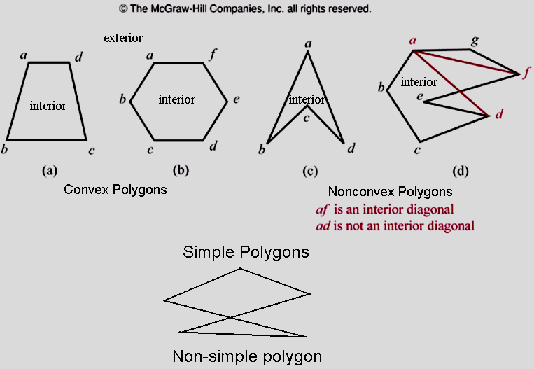
Using Strong Induction in Computational Geometry
Definitions

Slide 13
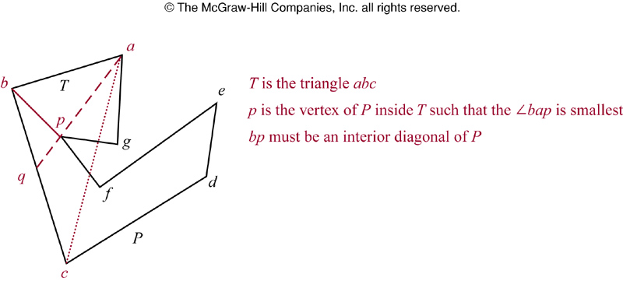
Strong Induction in Computational Geometry
Lemma 1: Every simple polygon has an interior diagonal.
Proof: page 290

Slide 14
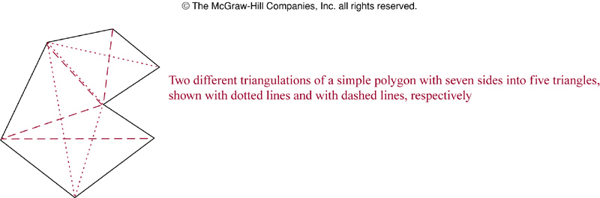
Strong Induction in Computational Geometry
Theorem 1:
A simple polygon with n sides, where n is integer with n ≥ 3, can be triangulated into n-2 triangles
Proof: page 289

Slide 15
4.3- Recursive Definition and
Structural Induction
Introduction
Recursively Defined Functions
Recursively Defined Sets and Structures
Structural Induction
Generalized Induction
Recursive Algorithms

Slide 16
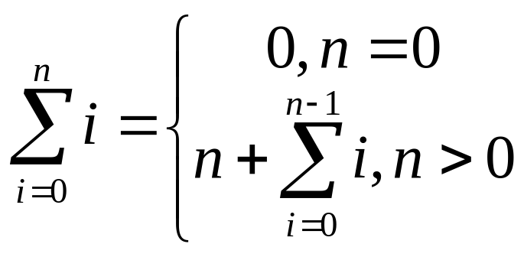
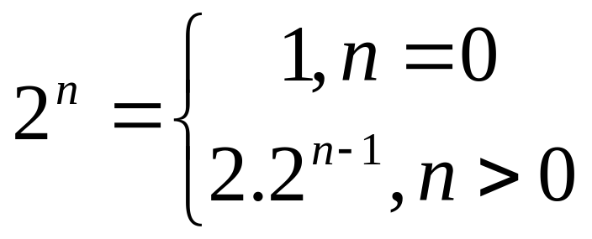
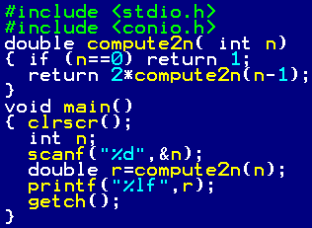
Recursion: Introduction
Objects/ functions may be difficultly defined.
Define an object/function in terms of itself
Examples:

Slide 17
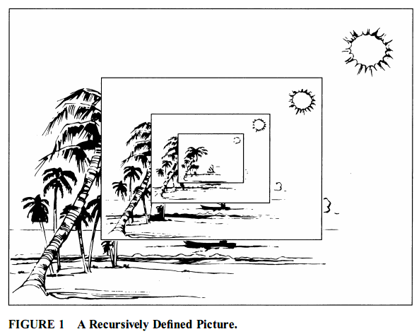

Slide 18
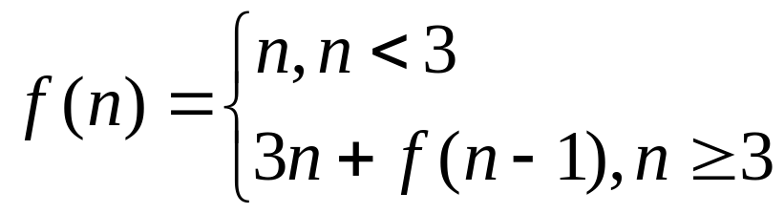
Recursively Defined Functions
Recursive ( inductive) function
Two steps to define a function with the set of nonnegative integers as its domain:
Basis step: Specify the value of the function at zero.
Recursive step: Give a rule for finding its value at an integer from its values at smaller integers
Example: Find f(1), f(2), f(4),f(6) of the following function:

Slide 19
Recursively Defined Functions
Example: Give the recursive definition of ∑a_{i} , i=0..k
Basis step: ∑a_{i} =a₀, i=0
Inductive step:
a₀ + a₁ + … + a_{k-1} + a_{k}
( ∑a_{i} , i=0..k-1)
∑a_{i} =a_{k} + ( ∑a_{i} , i=0..k-1)

Slide 20
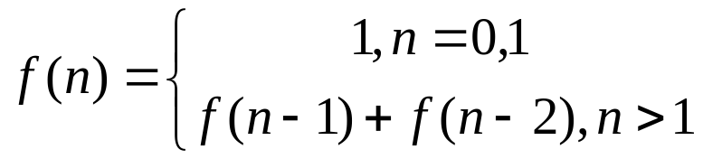
Recursively Defined Functions
Definition 1: Fibonacci numbers
Theorem 1: Lamé’s theorem: Let a,b be integers, a ≥ b. Then the number of divisions used by the Euclidean algorithm to find gcd(a,b) is less than or equal to five times the number of decimal digits in b.
Proof: page 298
Example gcd(25,7), b= 7 , 1 digit
x y r
25 7 25 mod 7=4
7 4 7 mod 4=3
4 3 4 mod 3=1
3 1 3 mod 1=0 ( 4 divisions)
1 0 Stop
procedure gcd(a,b)
x:=a; y:=b
while y ≠ 0
begin
r := x mod y
x:=y
y:= r
end { gcd(a,b) is x}

Slide 21
Recursively Defined Sets and Structures
Example S= { 3,6,9,12,15, 18,21,…}
Step 1: 3∈S
Step 2: If x∈S and y∈S then x+y∈S
Definition 2: The set ∑* of string over alphabet ∑ can be defined recursively by:
Basis step: λ ∈ ∑*, λ is the empty string with no symbols
Recursive step: If w∈ ∑* and x∈ ∑ then wx∈ ∑*
Example: ∑ ={0,1} ➔ ∑* is the set of string made by 0 and 1 with arbitrary length and arbitrary order of symbols 0 and 1

Slide 22
Recursively Defined Sets and Structures
Definition 3: String Concatenation ()
Basis step: If w ∈ ∑* then wλ=w, λ is the empty string
Recursive step: If w₁∈ ∑* and w₂∈ ∑* and x∈ ∑ then w₁(w₂x) =(w₁w₂)x
Example: ∑ ={0,1} ➔ ∑* is the set of string made by 0 and 1 with arbitrary length and arbitrary order of symbols 0 and 1

Slide 23
4.4- Recursive Algorithms
Definition 1: An algorithm is called recursive if it solves a problem by reducing it to an instance of the same problem with smaller input.
Example: Recursive algorithm for computing n!
procedure factorial (n: nonnegative integer)
if n=0 then factorial(n) :=1
else factorial(n) = n.factorial(n-1)
n!= 1 , n=0
n!= 1.2.3.4…n = n.(n-1)!, n>0
Notes:
We can build a recursive algorithm that finds n!, where n is a nonnegative integer, based on the recursive definition of n!.
To find n! for a particular integer, we use the recursive step n times.

Slide 24
Recursive Algorithms…
Example: Recursive algorithm for computing a^{n}
procedure power (a: nonzero real number
n: nonnegative integer)
if n=0 then power(a,n) :=1
else power(a,n)=a.power(a,n-1)
a^{n}= 1 , n=0
a^{n}= a.a.a…a = a.a^{n-1}, n>0
Notes:
- We can base a recursive algorithm on the recursive definition of a^{n}.

Slide 25
Recursive Algorithms…
Example: Recursive algorithm for computing b^{n} mod m m ≥ 2, n ≥ 0, 1 ≤ b < m.
b^{n} mod m = (b.(b^{n-1} mod m) mod m
b⁰ mod m = 1
Using division to improve performance: ( n steps backward to 0 faster)
If n is even → b^{n} = b^{n/2}.b^{n/2}
→ b^{n} mod m = ((b^{n/2} mod m). (b^{n/2} mod m)) mod m
→ b^{n} mod m = (b^{n/2} mod m)² mod m
If n is odd→ b^{n} = b.b ^{⎣n/2⎦}.b ^{⎣n/2⎦}
→ b^{n} mod m = ([(b ^{⎣n/2⎦} mod m)² mod m].(b mod m))mod m
Algorithm: page 313
Notes:
-

Slide 26
Recursive Algorithms…
Example: Recursive algorithm for computing gcd(a,b) a,b: non negative integer, a < b
If a>b then swap a,b
gcd(a,b)=b , a=0
gcd (a,b) = gcd(b mod a, a)
Algorithm: page 313
Notes:
- The algorithm is a recursive version of the Euclidean algorithm.

Slide 27
Recursive Algorithms…
Example: Recursive algorithm for linear searching the value x in the sequence
a_{i}, a_{i+1},…, a_{j}, sub-sequence of a_{n}.
1≤ i ≤ n, 1 ≤ j ≤ n
i>j → location =0
a_{i}=x → location = i
location (i, j, x) = location ( i+1, j, x)
Algorithm: page 314 – You should modify it.

Slide 28
Recursive Algorithms…
Example: Recursive algorithm for binary searching the value x in the increasingly ordered sequence a_{i}, a_{i+1},…, a_{j-1}, sub-sequence of a_{n}. 1≤ i ≤ n, 1 ≤ j ≤ n
1≤ i ≤ n, 1 ≤ j ≤ n
procedure binary-search(x, i, j)
if i>j then location=0
m= ⎣(i+j)/2⎦
if x= a_{m} then location =m
else if x< a_{m} then location= binary-search(x, i, m-1)
else location= binary-search(x, m+1, j)
Algorithm: page 314 – You should modify it.

Slide 29
Proving Recursive Algorithms Correct
Using mathematical induction.
Example: prove the algorithm that computes n! is correct.
procedure f (n: nonnegative integer)
if n=0 then f(n) :=1
else f(n) = n.f(n-1)
If n=0, first step of the algorithm tells us f(0)=1 ➔ true
Assuming f(n) is true for all n≥0
f( n)= 1.2.3….(n)
(n+1).f(n)= 1.2.3…n.(n+1) = (n+1)!
f(n+1) = (n+1)!
Conclusion: f(n) is true for all integer n, n≥0
More examples: Page 315
Notes:
- Mathematical induction, and its variant strong induction, can be used to prove that a recursive algorithm is correct, that is, that it produces the desired output for all possible input values.

Slide 30
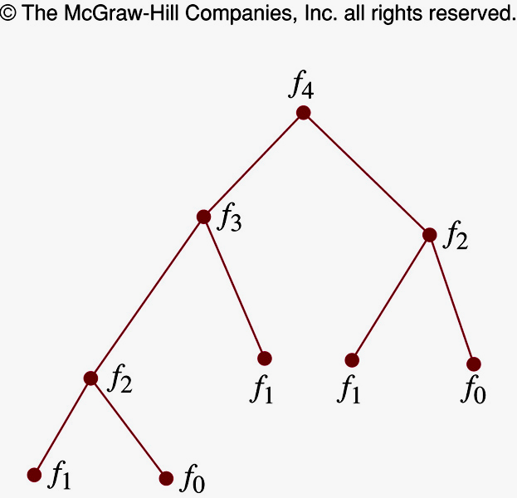
Recursion and Iteration
procedure rfibo (n: nonnegative integer)
If n=0 then rFibo(0)=0
Else if n=1 then rFibo(1)=1
Else rFibo(n) := rFibo(n-2) + rFibo(n-1)
procedure iFibo (n: nonnegative integer)
If n=0 then y:=0
Else if n=1 then y:=1
Else Begin
x:=0 ; y:=1
for i:= 2 to n
Begin
z:= x+y; x:= y; y:=z
End
End { iFibo(n) = z}
Recursive algorithm uses far more computation than iterative one
Notes:
To find the Fibonacci f_{n}, the recursive algorithm this algorithm requires f_{n+1} -1 additions.
Only n -1 additions have been used to find f_{n} with the iterative approach.

Slide 31
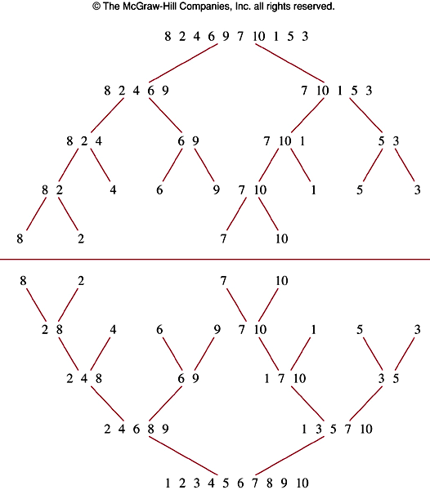
Merge Sort
Procedure mergeSort (
L=a₁…a_{n})
If n>1 then
Begin
m:= ⎣n/2⎦
L1 := a₁…a_{m}
L2 := a_{m+1}…a_{n}
L:=merge(mergeSort(L1),mergeSort(L2))
End
{L is sorted}
Merge?

Slide 32

Merge Sort
L1: 1 2 2 5 7 9 12 15 17 19
L2: 3 5 8 9 11 15
≤
L : 1 2 2 3 5 5 7 8 9 9 11 12 15 15 17 19
Merge two sorted lists L1, L2 to list L, an increasing ordered list.
procedure Merge (L1, L2: sorted list)
L:= empty list
While L1 and L2 are both no empty
Begin
remove smaller of first element of L1 and L2
and put it to the right end of L
if removal of this element makes one list empty then remove all elements from the other list and append them to L
End { L has increasing order }
Theorem 1: The number of comparisons needed to merge sort a list with n elements is O(nlog n)

Slide 33
Summary
Mathematical Induction
Strong Induction and Well-Ordering
Recursive Definitions and Structural Induction
Recursive Algorithms

Slide 34
Thanks

